Slide 1

Chapter 5
Access Control and Management

Slide 2

What is Access Control?
Access control refers to the process of granting or denying permission to utilize specific resources within a system or environment. It ensures that only authorized individuals can access certain data, systems, or facilities.
Physical Access Control Involves physical barriers such as fences, hardware-based door locks, and mantraps that control and limit direct access to devices and sensitive areas.
Technical Access Control Uses technological solutions to restrict user access to data or systems. This may involve software-based mechanisms that limit user permissions on networks or devices.
Standard Access Control Models Various models are established to ensure systematic enforcement of access control. These models help organizations define and implement who can access what within a system based on pre-set rules and permissions.

Slide 3
Access Control Terminology (1 of 5)
Identification
The process of claiming an identity by presenting credentials, allowing the system to recognize a user or entity.
Example: A delivery driver shows an employee badge, indicating who they are.
Authentication
Verifies the identity by checking the validity of the credentials presented during identification.
Example: The system or person examines the delivery driver’s badge to confirm their identity.
Authorization
Grants permissions based on the identity's verified credentials, allowing the individual to take specific actions.
Example: The driver is allowed to pick up a package based on their authorization.
Accounting
Keeps track of the actions performed, maintaining a log of who accessed the system,
what they accessed, and when they disconnected.
Example: A record shows that the driver accessed the system at a certain time to retrieve a package.

Slide 4
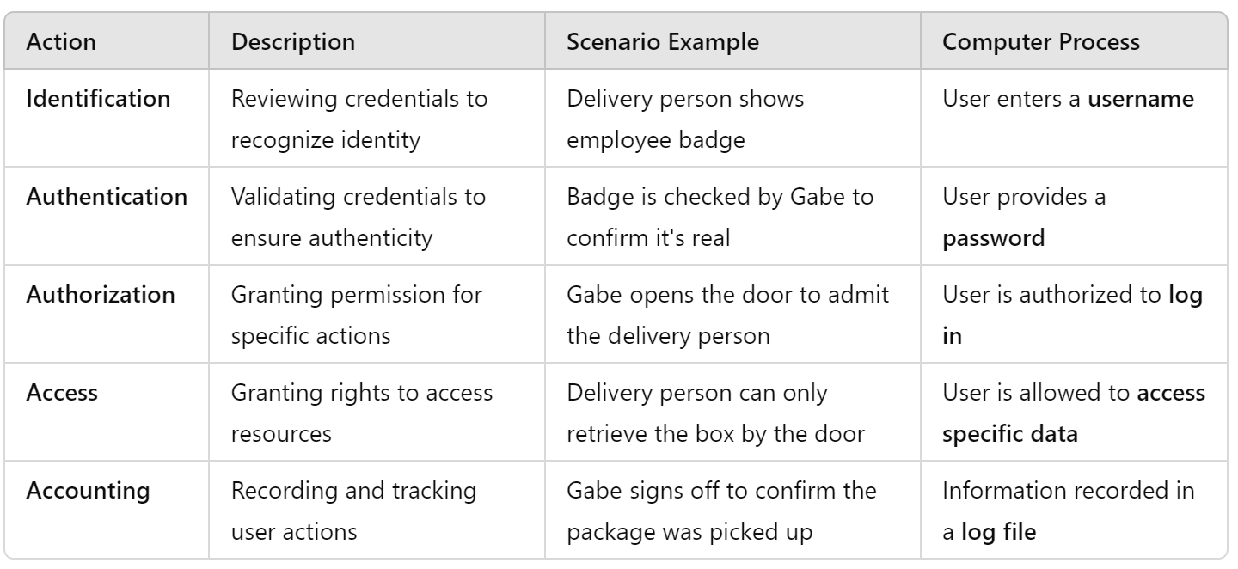
Access Control Phases: Explanation and Computer Process

Slide 5
Access Control Terminology (3 of 5)
Object: Represents a specific resource that is protected within the system. Example: A file or a hardware device.
Subject: A user or process that interacts with the object, typically functioning on behalf of a user. Example: A computer user performing actions within a system.
Operation: The action taken by the subject on the object, dictating the interaction between the two. Example: Deleting a file or modifying hardware settings.

Slide 6
Access Control Terminology (4 of 5)
Key Roles in Data Privacy and Security
Privacy Officer:
Description: Manager responsible for overseeing data privacy compliance and managing data risks.
Duties: Ensures the enterprise complies with data privacy laws and internal privacy policies.
Example: Decides which users can access specific sensitive files like SALARY.XLSX.
Custodian or Steward:
Description: Individual assigned to perform day-to-day tasks by the owner.
Duties: Regularly reviews security settings and maintains access records for end users.
Example: Sets and reviews security settings for files like SALARY.XLSX.
Owner:
Description: Person responsible for the data or information.
Duties: Determines the required security level for data and delegates security responsibilities as necessary.
Example: Sets permissions on SALARY.XLSX so it is accessible only to department managers.
End User:
Description: User who accesses data as part of their job responsibilities.
Duties: Follows the organization's security policies and does not attempt to bypass security controls.
Example: Accesses files such as SALARY.XLSX in the course of daily work.

Slide 7
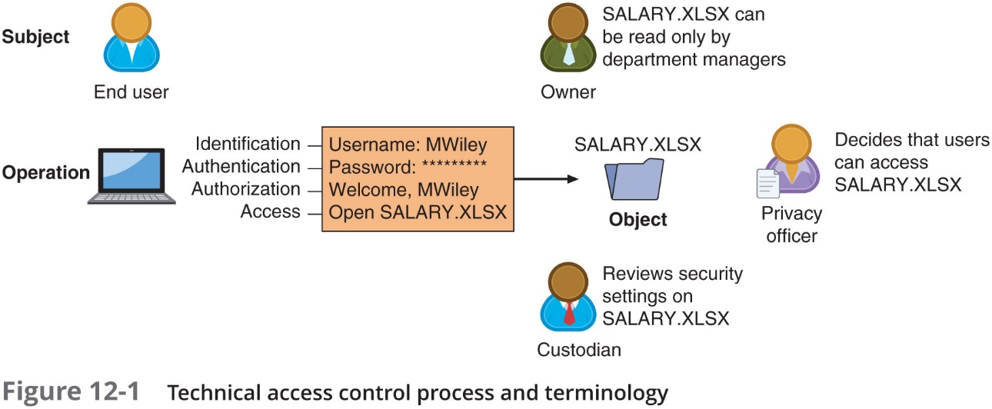
Access Control Terminology (5 of 5)

Slide 8
Access Control Models
Access control models provide standardized frameworks for hardware or software developers to configure the appropriate level of security and control over resources. These models help define how access permissions are managed and enforced. There are five major access control models:
Discretionary Access Control (DAC):
The resource owner decides who can access specific resources.
Users can transfer permissions to others, allowing flexible management of access.
Mandatory Access Control (MAC):
Access is based on policies set by the system or organization, not by the users.
Typically used in highly classified environments (e.g., government systems).
Role-Based Access Control (RBAC):
Access permissions are assigned based on user roles within an organization.
Users inherit permissions based on their role, streamlining management.
Rule-Based Access Control:
Access is granted or denied based on pre-defined rules.
These rules can be adjusted based on the context of the request, such as time of access or the device used.
Attribute-Based Access Control (ABAC):
Access control is based on attributes (e.g., user, environment, or resource characteristics).
This allows for more flexible and fine-grained access control.

Slide 9
Discretionary Access Control (DAC) (1 of 2)
Least Restrictive Model: DAC is the least restrictive of the access control models. In DAC, every object (files, directories, etc.) has an owner, who has full control over the object.
Owner Control: Owners can decide who has permissions to access their objects and can transfer those permissions to other users.
Commonly Used in OS: It is widely implemented in operating systems such as various types of UNIX and Microsoft Windows.
Weaknesses:
User-Dependent: The system relies heavily on the end user to set the correct security permissions, which poses a risk if the user does not implement proper security measures.
Inheritance of Permissions: Any programs executed by a user will inherit the user’s permissions. This can lead to security vulnerabilities if malicious programs gain the same access rights as the user.

Slide 10
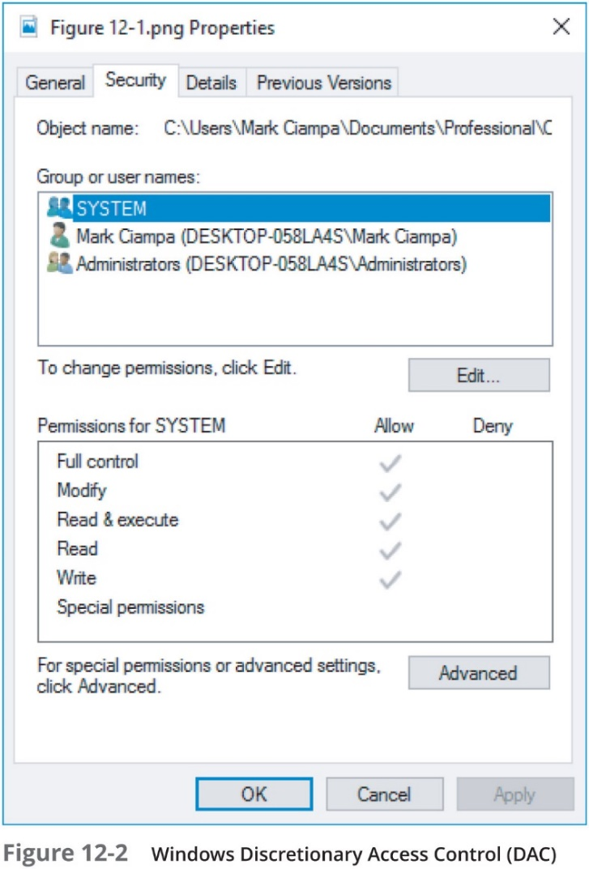
Discretionary Access Control (DAC) (2 of 2)

Slide 11
Mandatory Access Control (MAC) (1 of 4)
Most Restrictive Model: This model is the most restrictive among access control frameworks. It operates by entirely removing the user's ability to set permissions. Users cannot distribute access to other subjects.
Common in Military Settings: The MAC model is widely used in military or highly confidential environments where strict access control is essential.
Two Key Elements:
Labels: Every entity, whether it is a subject or an object, is assigned a classification label. These labels represent the importance of the entity. For example, objects are labeled as Top Secret, Secret, or Confidential, while subjects are assigned clearance labels.
Levels: The labels operate within a hierarchy. For example, "Top Secret" is higher than "Secret," which is higher than "Confidential."
Permission Matching: MAC grants access by matching the subject's privilege label with the object's classification label. Only subjects with sufficient clearance can access higher-labeled objects.
Strict Labeling for Privilege: The access control is dictated by these labels, ensuring that only authorized personnel access sensitive information, following a "need-to-know" basis.

Slide 12
Mandatory Access Control (MAC) (2 of 4)
Comparison of Object and Subject Labels: In MAC, the subject’s access to a file or resource is determined by comparing their labels with the object’s (file's) labels.
Access Rules: For access to be granted, the subject's label must be equal to or greater than the object’s classification label.
Two Major Implementations of MAC:
Lattice Model:
Subjects and objects are assigned specific positions or "rungs" in a hierarchy.
Access is based on this hierarchical structure, where multiple lattices can coexist.
Bell-LaPadula (BLP) Model:
Similar to the lattice model, but with stricter rules.
BLP restricts subjects from creating new objects or performing functions on objects at lower security levels. This prevents data leakage to lower classification levels.

Slide 13
Mandatory Integrity Control (MIC) in Microsoft Windows (3 of 4)
Implementation of MAC in Windows: Microsoft Windows enforces a version of Mandatory Access Control (MAC) through Mandatory Integrity Control (MIC).
Security Identifier (SID): A unique Security Identifier (SID) is assigned to users, groups, or sessions.
This SID is retrieved whenever a user logs in and is used to track and identify the user during interactions with the system.
Windows Integrity Levels: Windows links the SID to an integrity level, which is used to control access permissions. Higher integrity levels provide more privileges, while lower ones are more restricted.
User Access Control (UAC): This is a security feature in Windows that ensures users cannot perform high-privileged operations unless explicitly authorized. It prevents unauthorized applications from gaining elevated access.

Slide 14
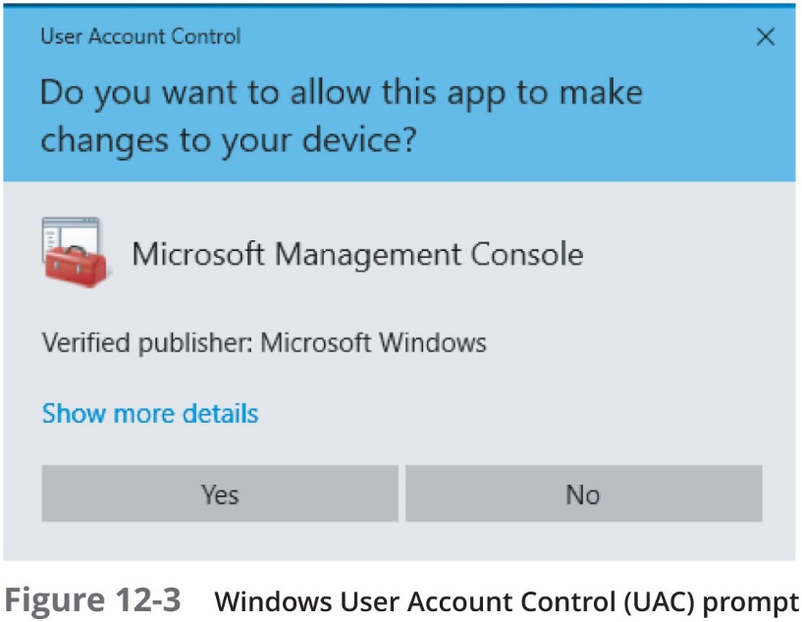
Mandatory Access Control (M A C) (4 of 4)

Slide 15
Role-Based Access Control (RBAC)
Definition: RBAC is a method of regulating access to resources based on the roles individuals have within an organization. It is sometimes referred to as Non-Discretionary Access Control because users do not have the discretion to set their own access privileges.
Role Assignment: Access permissions are tied to specific roles within the organization, and users are assigned to roles based on their job functions.
Permission Management: Permissions are centrally managed by administrators who assign them based on predefined roles, ensuring that only authorized users can access specific resources according to their responsibilities.

Slide 16
Rule-Based Access Control
Rule-Based Role-Based Access Control (RB-RBAC)
Definition: A variation of Role-Based Access Control (RBAC) that dynamically assigns roles to users based on a set of predefined rules managed by a custodian.
Rule-Based Permissions: Each resource contains access rules. When a user attempts access, the system verifies these rules to determine if access is permitted.
Use Case: RB-RBAC is frequently employed to manage user access across multiple systems and is particularly useful when business changes trigger updates to the access control rules.
Dynamic Flexibility: This model ensures that access permissions can be adjusted dynamically based on the evolving rules of an organization.

Slide 17
Attribute-Based Access Control (1 of 2)
Flexibility: ABAC provides more adaptable policies compared to Rule-Based Access Control (RBAC), allowing a combination of multiple attributes to determine access.
Attributes Used: The model can incorporate:
Object attributes (e.g., file type or sensitivity)
Subject attributes (e.g., user role or department)
Environmental attributes (e.g., time of access or location)
Conditional Rules: Policies in ABAC are commonly structured using "If-Then-Else" logic, enabling a high degree of granularity in access control decisions.
This flexibility allows ABAC to support complex organizational needs by leveraging a diverse range of criteria.

Slide 18
Attribute-Based Access Control (2 of 2)
Name | Explanation | Description
Mandatory Access Control (M A C) | End user cannot set controls | Most restrictive model
Discretionary Access Control (D A C) | Subject has total control over objects | Least restrictive model
Role-Based Access Control (R B A C) | Assigns permissions to particular roles in the organization and then users are assigned to roles | Considered a more “real-world” approach
Rule-Based Access Control | Dynamically assigns roles to subjects based on a set of rules defined by a custodian | Used for managing user access to one or more systems
Attribute-Based Access Control (A B A C) | Uses policies that can combine attributes | Most flexible model

Slide 19

Managing Access Through Account Management
Properly configuring accounts is a first step in providing strong security
Accounts include not only user accounts but also:
Service accounts
Privileged accounts
Account management includes account setup as well as account auditing

Slide 20
Account Setup
Best Practices for Account Setup:
Location-Based Policies: Implementing access control policies based on the geographical location of users, allowing or restricting access depending on where the login request is made.
Standard Naming Conventions: Establish a consistent naming system for user accounts to maintain clarity and organization across the network, making it easier to manage and audit access.
Time-of-Day Restrictions: Limit access based on specific times of the day or week, ensuring that users can only log in during their working hours or other permitted timeframes, enhancing security.
Least Privilege Enforcement: Assign users the minimal level of access necessary to perform their duties, preventing unauthorized or unnecessary access to sensitive data or systems. This ensures better control over who can access specific resources and reduces the risk of insider threats.

Slide 21
Location-Based Policies
Geofencing and Location-Based Policies:
Geofencing: A technique used to define geographical boundaries where mobile devices can or cannot be used. It helps ensure that devices are only operational in authorized areas.
IP Location Data: Geofencing often relies on IP location data to define these boundaries. The data is stored in a file that contains information such as the range of IP addresses (IP_From, IP_To), the country code, country name, region, and city.
Policy Generation: This IP location data file becomes the foundation for generating location-based policies that govern where mobile devices can access certain systems. For example, mobile devices may be restricted from accessing sensitive data outside of a designated geographic area.
Authorization Requests: When mobile devices attempt to access resources, the system evaluates authorization requests against the predefined geofencing policies. If a device is outside the approved geographical boundaries, the request may be denied.

Slide 22
Standard Naming Conventions
Standard Naming Conventions
Definition: These are predefined rules established for creating account names in a consistent manner across an organization.
Common Options:
First initial of the first name followed by the last name (e.g., jsmith).
Full first name with a punctuation mark followed by the last name (e.g., john.smith).
Last name followed by a department code (e.g., smith_hr).
Conflict Resolution: In cases where two users have similar or identical names, a standard procedure should be implemented to resolve the naming conflict. This could involve appending a number or other identifier to the username.
Purpose: Standard naming conventions ensure ease of identification, uniformity, and avoid confusion in large organizations, making account management more streamlined.

Slide 23
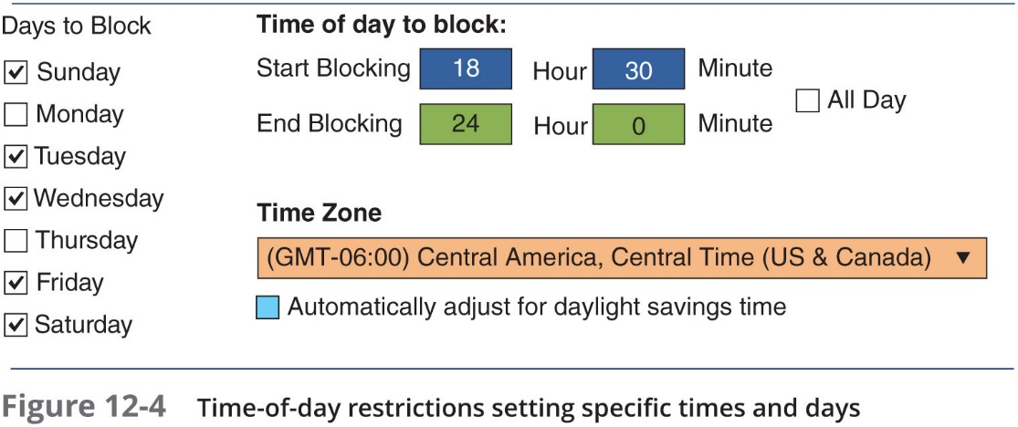
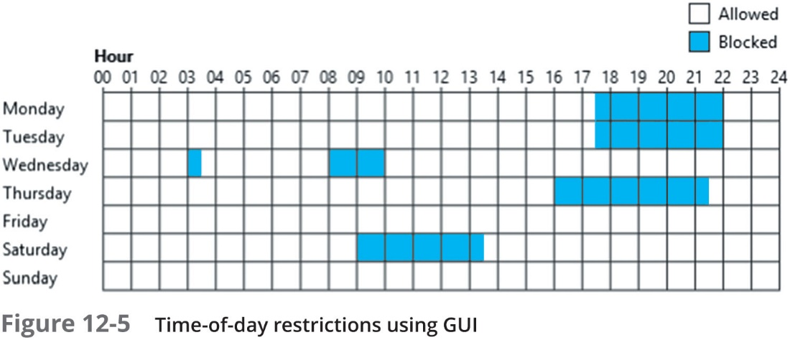
Time-of-Day Restrictions
Time-of-day restrictions can be used to limit when a user can log into their account

Slide 24
Least Privilege
Least Privilege in Access Control
Definition: The principle of least privilege dictates that individuals or systems should only be granted the minimum levels of access—or permissions—necessary to complete their tasks.
Purpose: By limiting the number of privileges, it reduces the attack surface, minimizing the potential avenues for attackers to exploit vulnerabilities within a system.
Application: This principle applies both to user accounts and to system processes. For example, users are only given access to the data and applications they need, and processes are only granted the permissions necessary to perform their function.
Security Benefits: By eliminating unnecessary privileges, the risk of privilege escalation attacks and misuse is significantly reduced.

Slide 25
Account Auditing
Once user accounts are created, it’s critical to maintain and audit them regularly to ensure they are up-to-date and comply with security policies. The following auditing processes can be applied:
Recertification: A periodic revalidation process that ensures a user’s account, access controls, and membership roles are still appropriate and necessary. It confirms that users should still have the access they were originally granted.
Permission Auditing and Review: This process involves examining the specific permissions granted to a user. The audit determines whether these permissions are still required based on the user's current role and responsibilities.
Usage Auditing and Review: Focuses on how users are interacting with the applications they have access to. This review looks at the frequency and manner in which applications are used to identify any unnecessary or risky usage patterns.

Slide 26
Best Practices for Access Control
Establishing best practices for limiting access
Can help secure systems and data
Examples of best practices
Separation of duties
Job rotation
Mandatory vacations
Clean desk policy

Slide 27
Separation of Duties
Separation of duties
Fraud can result from a single user being trusted with complete control of a process
Requires two or more people responsible for functions related to handling money
The system is not vulnerable to actions of a single person
In relation to computer access control
Requires that if the fraudulent application of a process could potentially result in a breach of security, the process should be divided between two or more individuals

Slide 28
Clean Desk Policy
Designed to ensure that all confidential or sensitive materials are removed form a user’s workspace and secured when the items not in use
Either in paper form or electronic
Sample statements that might be found in a clean desk policy:
Computer workstations must be locked when the workspace is unoccupied and turned off at the end of the day
Confidential or sensitive information must be removed from the desk and locked in a drawer or safe when the desk is unoccupied or at the end of a work day
File cabinets must be kept closed and locked when not in use or not attended, and keys may not be left at an unattended desk
Laptops must be either locked with a locking cable or locked in a drawer or filing cabinet

Slide 29
Implementing Access Control
Technologies for Access Control
Access Control Lists (ACLs): These are lists that define permissions attached to an object, specifying which users or system processes are granted access to objects and what operations are allowed on given objects.
Group-Based Access Control: Instead of assigning permissions to individual users, permissions are assigned to groups, and users inherit the permissions of the groups they are part of. This simplifies the management of user permissions, especially in larger organizations.

Slide 30
Access Control Lists (A C L s) (1 of 2)
Access Control Lists (ACLs)
Definition: ACLs are sets of permissions attached to objects, specifying which subjects (users, groups, etc.) may access those objects and what operations they can perform (e.g., read, write, execute).
Process: When a subject requests to perform an operation on an object, the system checks the ACL for an approved entry.
Usage:
Operating Systems: ACLs are widely used in operating systems to provide file system security.
SQL/Database Systems: ACLs have been adapted for relational database systems to ensure database security.

Slide 31
Access Control Lists (A C L s) (2 of 2)
Each entry in an Access Control List (ACL) is referred to as an Access Control Entry (ACE).
Structure of an ACE in Windows:
Security Identifier (SID): A unique value that represents a user, group, or logon session.
Access Mask: Specifies which access rights the ACE controls.
Flag: Indicates the type of ACE (such as allowing or denying access).
Inheritance Flags: Determine if and how permissions are inherited by child objects.
This structure allows fine-grained control over how different users or processes can interact with system resources.

Slide 32
Group-Based Access Control
Group-Based Access Control enables the management of access control policies for multiple computers by setting a single unified policy.
Key Points:
Group Policy is a feature in Microsoft Windows that provides centralized management and configuration of systems, especially in enterprise environments.
It allows for managing computers and remote users using Active Directory (AD).
Settings are stored in Group Policy Objects (GPOs).
Local Group Policy (LGP): Used for systems not part of AD and offers fewer options than the

Slide 33
Identity and Access Services
Identity and Access Services:
There are various services and protocols that can be used to manage identity and access control effectively, including:
RADIUS (Remote Authentication Dial-In User Service):
Provides centralized Authentication, Authorization, and Accounting (AAA) for users who connect and use a network service.
Kerberos:
A secure method for authenticating a request for a service in a computer network using secret-key cryptography.
TACACS (Terminal Access Controller Access-Control System):
Handles remote authentication for network access, providing centralized control and ensuring security.
LDAP (Lightweight Directory Access Protocol):
A protocol for accessing and maintaining distributed directory information services over an Internet Protocol (IP) network.
SAML (Security Assertion Markup Language):
An XML-based framework for authentication and authorization between an identity provider and a service provider.
Authentication Framework Protocols:
Various protocols that support and standardize the process of authentication in different environments and applications.

Slide 34
R A D I U S (1 of 2)
Remote Authentication Dial-In User Service (RADIUS):
RADIUS has become an industry-standard for managing remote access.
Original Purpose: Initially created to provide authentication, authorization, and accounting for users accessing a corporate network remotely via dial-in.
RADIUS Client: Typically a network device (e.g., wireless access point) that communicates user credentials and connection information to the RADIUS server.
Centralized User Profiles: User profiles are centrally stored in a database accessible by all remote servers, allowing for seamless access control and data sharing across the network.
Advantages of Centralized Service:
Enhanced Security: Since RADIUS centralizes authentication at one controlled point, the security of the entire network can be effectively managed and monitored.
Simplified Billing and Network Statistics: Centralizing user profiles and authentication makes it easier to track user activity, improving accuracy in usage monitoring for billing and statistical analysis.

Slide 35
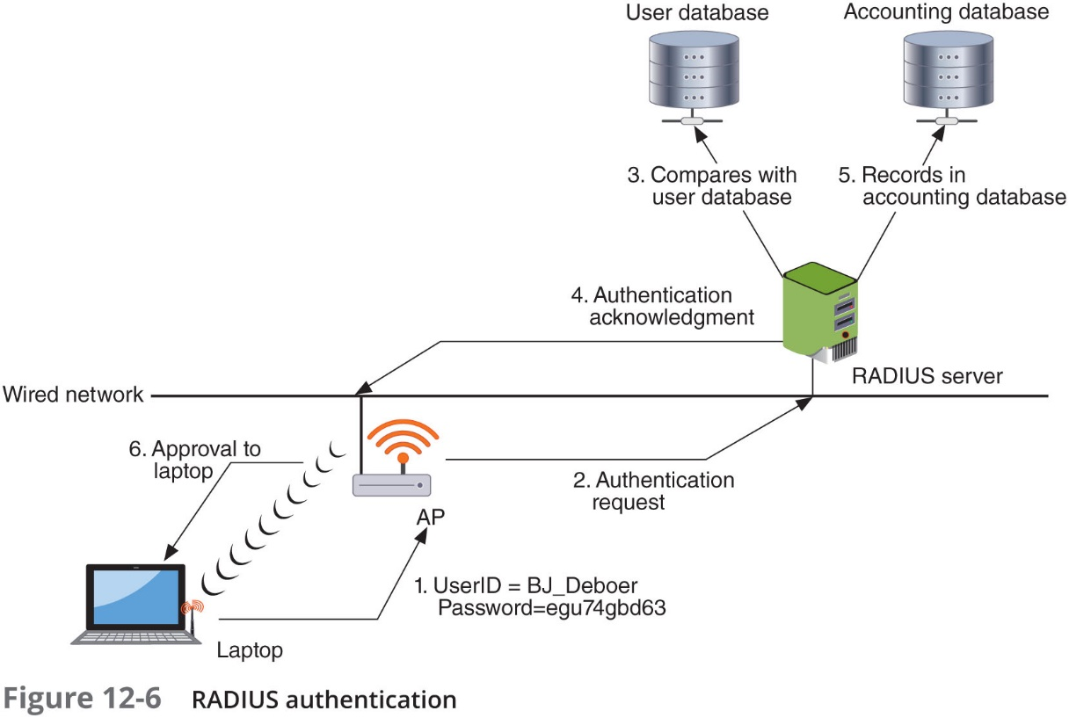
R A D I U S (2 of 2)

Slide 36
Kerberos
Kerberos Authentication System:
Developed at MIT: Kerberos is an authentication protocol designed to provide secure communication by using encryption and ensuring that only authorized parties can access the system.
Security via Encryption: It employs strong encryption methods to authenticate users, providing an extra layer of protection for sensitive data.
Analogy: Think of Kerberos as working similarly to using a driver’s license to cash a check – it proves your identity before granting access to services.
Kerberos Ticket Characteristics:
Difficult to Duplicate: Kerberos tickets are designed to be unique and challenging to copy, ensuring security and authenticity.
User-Specific Information: Each ticket contains data that links it specifically to the authorized user, preventing unauthorized use.
Defined Restrictions: The ticket lists permissions and access limitations associated with the user.
Expiration: Kerberos tickets have an expiration date to limit their validity and reduce the risk of misuse over time.

Slide 37
Terminal Access Control Access Control System+ (T A C A C S +) (1 of 2)
TACACS+ (Terminal Access Controller Access-Control System Plus):
Authentication Service: TACACS+ functions similarly to RADIUS but with more granular control over user authentication, authorization, and accounting (AAA).
Primarily for UNIX Systems: It is frequently deployed on UNIX-based systems to facilitate centralized authentication management.
Communication: The protocol forwards user authentication data to a centralized server, where the authentication decisions are made.
Current Version: TACACS+ is the latest version, offering enhanced security features and extended support for multiple protocols compared to its predecessors.

Slide 38
Terminal Access Control Access Control System+ (T A C A C S +) (2 of 2)
Feature | RADIUS | T A C A C S+
Transport Protocol | User Datagram Protocol (U D P) | Transmission Control Protocol (T CP)
Authentication and authorization | Combined | Separate
Communication | Unencrypted | Encrypted
Interacts with Kerberos | No | Yes
Can authenticate network devices | No | Yes

Slide 39
Lightweight Directory Access Protocol (L D A P) (1 of 2)
Directory Services Overview:
Definition: A directory service is a centralized database on a network that stores crucial information about users, devices, and network resources.
Functionality: It tracks and manages network resources, including users' access rights and privileges, allowing it to grant or deny access to resources based on stored information.
X.500 Standard: A global standard designed to ensure uniformity in how directory data is stored and accessed across different systems, ensuring compatibility between various platforms.
LDAP (Lightweight Directory Access Protocol): Based on the X.500 standard, LDAP provides a simplified protocol that allows client applications to interact with directory services for querying and managing data efficiently.

Slide 40
Lightweight Directory Access Protocol (L D A P) (2 of 2)
Purpose & Design: LDAP is built to run over TCP/IP, offering a simplified subset of the DAP (Directory Access Protocol). It uses a less complex encoding method than the full X.500 standard, making LDAP more lightweight and efficient for most directory service use cases.
Security Considerations: By default, LDAP traffic is transmitted in plaintext, making it vulnerable to eavesdropping. However, LDAP can be secured by employing SSL (Secure Sockets Layer) or TLS (Transport Layer Security), resulting in Secure LDAP, also known as LDAP over SSL (LDAPS).
LDAP Injection Attacks: Similar to SQL injection, LDAP can be vulnerable to injection attacks when user input is improperly filtered. This type of attack can exploit weaknesses in how input is handled, allowing attackers to manipulate directory queries for malicious purposes. Proper input validation is essential to prevent these vulnerabilities.

Slide 41
Security Assertion Markup Language (S A M L) (1 of 2)
A protocol based on XML (Extensible Markup Language) that enables the secure exchange of authentication and authorization data between web domains.
Single Identity Provider: SAML allows login credentials to be stored with a central identity provider, eliminating the need for multiple service providers to store credentials, thus enhancing security and reducing redundancy.
Broad Usage: Extensively utilized in business-to-business (B2B) and business-to-consumer (B2C) online transactions.
Main Benefit: Facilitates seamless, federated identity management, enabling users to authenticate once and gain access to multiple applications or services across organizational boundaries.

Slide 42
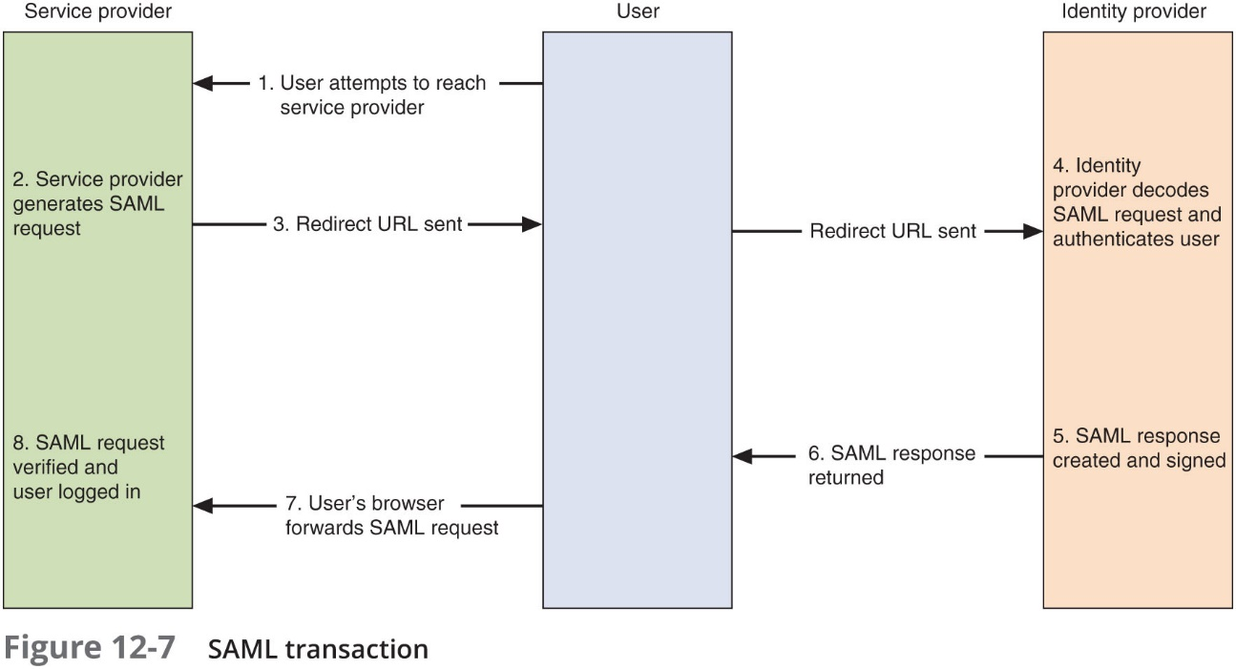
Security Assertion Markup Language (S A M L) (2 of 2)

Slide 43
Authentication Framework Protocol
Extensible Authentication Protocol (EAP)
A framework used for transporting authentication protocols in network environments.
Purpose: Created to provide a more secure alternative to legacy protocols such as:
CHAP: Challenge-Handshake Authentication Protocol
MS-CHAP: Microsoft’s version of CHAP
PAP: Password Authentication Protocol
Key Features:
Defines Message Formats: EAP doesn’t define any one specific authentication mechanism but instead outlines how to transport various authentication messages.
Four Packet Types:
Request: Initiates the authentication process.
Response: Replies to the request for authentication.
Success: Signals a successful authentication.
Failure: Indicates that authentication has failed.

